Slide 1
Discussion Unit:
Introduce DSE Security
Large topic, necessary for the enterprise
CSO or similar ? Get help
Multiple Levels
-- OS (Pre DSE)
-- DSE
-- Database connections (end user)
-- Inter-nodal communication
-- Data in flight
-- Data at rest
-- Files, (config, temp)
-- (Other)
DSE Core (and more), Security
Notes:
The goal of this Discussion Unit is introduce DSE Core (and more) Security.

Slide 2

Discussion Lab:
What is ? (Define the term)
Source: https://www.youtube.com/watch?v=5NhZXDU9FMo
Notes:
On the next page we enter a Discussion Lab.

Slide 3

Define the term: What is ?
Authentication
Authorization
Separation of Roles
Encryption at rest
Encryption in flight
RBAC
RLAC
TLAC
Auditing
“The forecast average loss for a breach of 1,000 records is generally over $$ (2015)
Source:https://www.verizonenterprise.com/verizon-insights-lab/dbir/
Notes:
Discussion Lab: define the terms-
Which comes first, authentication or authorization ?
Which term above most accompanies 'separation of roles' ?
Last question:
Source, https://www.verizonenterprise.com/verizon-insights-lab/dbir/
Between ($52,000 and $87,000)

Slide 4
End of Discussion Lab:
Notes:
End of Discussion Lab-

Slide 5
DSE 6 Security: Overview
Feature
Core
Search
Analytics
Graph
Authenticate, LDAP or Internal
Yes
Yes
Yes
Partial
Authenticate, Kerberos (Extern)
Yes
Yes
Yes
Yes
Authorize (RBAC)
Yes
Partial
Partial
Yes
Row Level perm (RLAC)
Yes
No
Yes
No
Client-to-node encryption
Yes
Yes
Yes
Yes
Node-to-node encryption
Yes
Yes
Yes
Yes
Transparent data encryption
Yes
Yes
No
Yes
Data auditing
Yes
Yes
Partial
Yes
Notes:
The table above supplies an overview of topics discussed on the pages that follow.

Slide 6

DSE Security: Authentication
"DSE Unified Authentication", database connections only
Inter-nodal (gossip, other)
-- SSL certificates
Database connections (client to node, tools and apps)
-- Internal, credentials by DSE
-- LDAP (including Active Directory)
-- Kerberos
PKI (Public key infrastructure)
KMIP (Key management interoperability protocol)
-- And encrypt data in flight (client to node SSL)
Practice Lab to follow
Notes:
Regarding authentication, the following is offered:
DSE inter-nodal traffic is authenticated using SSL, and the communication can be encrypted.
Reference Url,
Securing internal transactional node connections
https://docs.datastax.com/en/dse/6.0/dse-admin/datastax_enterprise/security/secInternodeSsl.html
Setting up Kerberos
Reference Url,
https://docs.datastax.com/en/dse/6.0/dse-admin/datastax_enterprise/security/secKerberosTOC.html
Setting up LDAP (LDAP v3 compatible servers)
Reference Url,
https://docs.datastax.com/en/dse/6.0/dse-admin/datastax_enterprise/security/secLDAPScheme.html
Microsoft Active Directory: Windows 2008, Windows 2012
OpenLDAP 2.4.x
Oracle Directory Server Enterprise Edition 11.1.1.7.0
JConsole, as a client, has special requirements
Reference Url,
Setting up SSL for jconsole (JMX)
https://docs.datastax.com/en/dse/6.0/dse-admin/datastax_enterprise/security/secureJconsoleSSL.html
Client to server communication can be encrypted.
Reference Url,
Securing client to cluster connections
https://docs.datastax.com/en/dse/6.0/dse-admin/datastax_enterprise/security/encryptClientNodeSSL.html
Specific to DSE Search
DSE Search (Apache Solr) Solr Admin UI is pre-integrated with Kerberos.
DataStax recommends using Kerberos authentication with the Solr Admin UI and when running commands with cURL using the SolrJ API.
To authenticate DSE Search clients with Kerberos authentication, use Simple and Protected GSSAPI Negotiation Mechanism (SPNEGO).
To use the SolrJ API against DSE Search clusters with Kerberos authentication, client applications must use the SolrJ-Auth library and the DataStax Enterprise SolrJ component as described in the solrj-auth-README.md file.
Define Accessing search indexes from Solr Admin UI (deprecated).
Perform index management tasks with the CQL shell using Enabling DSE Unified Authentication.
Specific to DSE Analytics
DataStax recommends the following security practices:
-- Enable client-to-node encryption using SSL.
-- Spark ports for internode communications should run within a secured network without exposure to outside traffic.
-- Distinct secrets for internode and per application, see Configuring Spark nodes.
-- Native authentication for users of each application executor (run as) and isolation of related data, see Configuring Spark nodes.
-- Spark UI internal or LDAP authentication, see Monitoring Spark with the web interface.
-- User authentication for Spark jobs. DataStax Enterprise supports internal, LDAP, and Kerberos authentication for Spark.
o Internal and LDAP: For DataStax Enterprise Spark applications and tools, use the Spark authentication commands to provide the authentication credentials, see Running spark-submit job with internal authentication.
o Kerberos: Defining a Kerberos scheme applies to connecting Spark to DSE database, not authenticating Spark components between each other. The Spark Web UI is not secured, so some parameters passed to the executor in the command line might be visible. However, the DSE username, password, and delegation token are hidden. By default, when Kerberos is the only authentication scheme, the Spark UI is inaccessible, so UI authorization must be disabled.
Specific to DSE Graph
DataStax Enterprise supports secure enterprise graph-database operations. DSE Graph data is completely or partially secured by using DataStax Enterprise security features:
Allow only authenticated users to access DSE Graph data by enabling DSE Unified Authentication on the transactional database and configure credentials in the DSE Graph remote.yaml.

Slide 7

DSE Security: Authorization
Role based access control (RBAC)
-- Only if authentication is enabled
Internal (credentials by DSE)
-- 1:1 mapping of user name to roles
LDAP
-- 1:M mapping, users assigned roles that
match groups in LDAP
Unbreakable
Source: https://www.imdb.com/title/tt0217869
Notes:
Specific to DSE Search
Reference Urls,
Managing search index permissions
https://docs.datastax.com/en/dse/6.0/dse-admin/datastax_enterprise/security/secSearchIndexPermissions.html
Setting row-level permissions with row-level access control (RLAC) is not supported for use with DSE Search or DSE Graph.
Specific to DSE Analytics
Data pulled from the database for Spark jobs and access control for Spark application submissions is protected by role-based access control (RBAC). The user running the request must have permission to access the data through their role assignment.
No authorization for the Spark UI master and workers is available.
Specific to DSE Graph
Reference Urls,
Managing access to DSE Graph keyspaces
https://docs.datastax.com/en/dse/6.0/dse-admin/datastax_enterprise/security/secRbacGraph.html
Limit access to graph data by defining roles for DSE Graph keyspaces and tables, see Managing access to DSE Graph keyspaces.
RBAC does not apply to cached data. Setting row-level permissions with row-level access control (RLAC) is not supported for use with DSE Search or DSE Graph.
Grant execute permissions for the DseGraphRpc object to the defined roles.
Graph Sandbox-
Enabled by default, the Graph sandbox can be configured to allow or disallow execution of Java packages, superclasses, and types, see,
https://docs.datastax.com/en/dse/6.0/dse-admin/datastax_enterprise/graph/config/configGraphSandbox.html

Slide 8
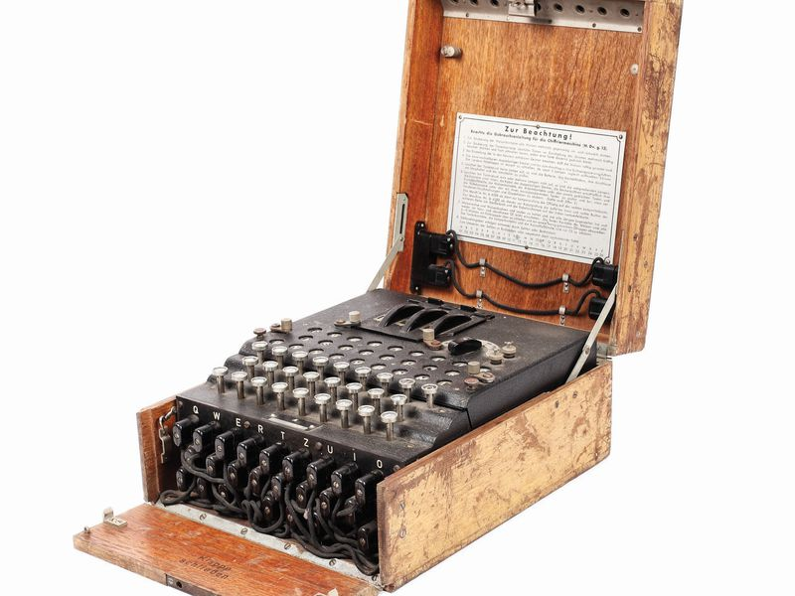
DSE: Encryption of Data in Flight
SSL encryption for data in-flight for the following components:
DSE transactional nodes
DSE Search (Apache Solr™)
DSE Analytics (Apache Spark™)
DSE Graph
DSE tools
DSE drivers
DSE OpsCenter
Notes:
Reference Urls,
https://docs.datastax.com/en/dse/6.0/dse-admin/datastax_enterprise/security/secSslTOC.html
Using CQL shell (cqlsh) with SSL,
https://docs.datastax.com/en/dse/6.0/dse-admin/datastax_enterprise/security/usingCqlshSslAndKerberos.html
Setting up SSL for nodetool, dsetool, and dse advrep
https://docs.datastax.com/en/dse/6.0/dse-admin/datastax_enterprise/security/secureToolSSL.html
Setting up SSL for jconsole (JMX)
https://docs.datastax.com/en/dse/6.0/dse-admin/datastax_enterprise/security/secureJconsoleSSL.html
Connecting sstableloader to a secured cluster
https://docs.datastax.com/en/dse/6.0/dse-admin/datastax_enterprise/security/secSstableloaderSsl.html
Other loaders, other-
See documentation specific to each

Slide 9

DSE: Encryption of Data at Rest
"Transparent Data Encryption (TDS)"
Entire tables (except for partition keys which are always stored in plain text)
SSTables containing data, including system tables (such as system.batchlog and system.paxos)
Search indexes
File-based Hints (in DSE 5.0 and later)
Commit logs
Sensitive properties in dse.yaml and cassandra.yam
TDE only applies to data stored in the database. DSE does not support encrypting data that is used by Spark and stored in DSEFS or local temporary directories.
Graph: Cached data is not encrypted. Encryption may slightly impact performance.
Notes:
Reference Urls,
https://docs.datastax.com/en/dse/6.0/dse-admin/datastax_enterprise/security/secEncryptTDE.html
Encrypting Search indexes
https://docs.datastax.com/en/dse/6.0/dse-admin/datastax_enterprise/security/secEncryptSearch.html

Slide 10
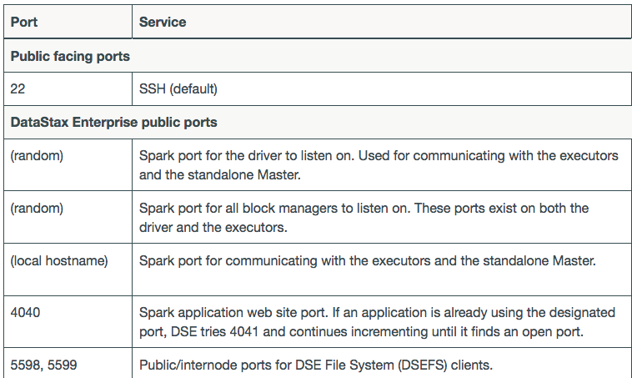
DSE: Securing Ports, Temp directories (JNA)
(20+ more)
Notes:
Reference Urls,
Securing DSE ports
https://docs.datastax.com/en/dse/6.0/dse-admin/datastax_enterprise/security/secFirewallPorts.html
Securing JNA (the temp directory)
https://docs.datastax.com/en/dse/6.0/dse-admin/datastax_enterprise/security/secTmp.html

Slide 11
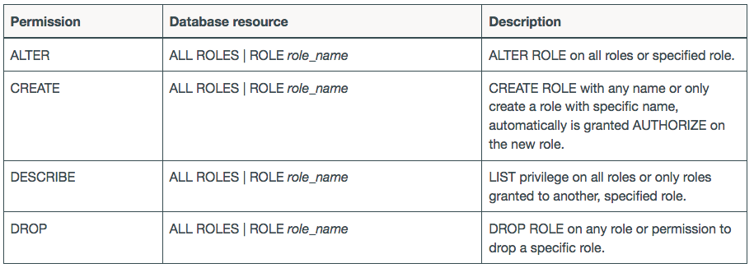
DSE: RBAC (Managing Roles)
Similar to any RDBMS
Keyspace Filtering
cassandra.yaml
system_keyspaces_filtering: true
User/role needs
DESCRIBE permission on
keyspace
Notes:
Reference Urls,
https://docs.datastax.com/en/dse/6.0/dse-admin/datastax_enterprise/security/secRBAC.html

Slide 12
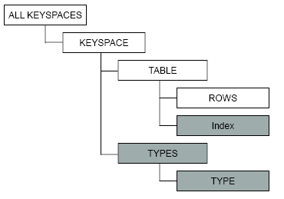

DSE: Object Hierarchy for GRANT|REVOKE
Row-level access control (RLAC) is disabled by default. To use RLAC, set allow_row_level_security parameter to true in the dse.yaml.
Notes:
Reference Urls,
https://docs.datastax.com/en/dse/6.0/dse-admin/datastax_enterprise/security/secDataResourcesAbout.html
Row-level access control (RLAC) is disabled by default. To use RLAC, set allow_row_level_security parameter to true in the dse.yaml

Slide 13
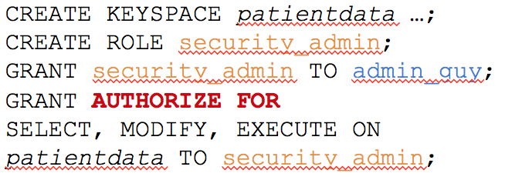
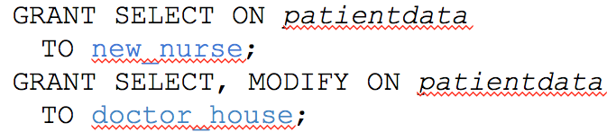
DSE: Audit Secure Subsystem
DataStax Enterprise (DSE) supports capturing database activity to a log file or table.
The audit logger also captures queries and prepared statements submitted by DataStax drivers, which use CQL binary protocol.
Security-
Separation of duties
Tuning, Capacity planning
Notes:
Reference Urls,
https://docs.datastax.com/en/dse/6.0/dse-admin/datastax_enterprise/security/secAuditTOC.html
Log formats
https://docs.datastax.com/en/dse/6.0/dse-admin/datastax_enterprise/security/secAuditLogFormat.html
Viewing events
https://docs.datastax.com/en/dse/6.0/dse-admin/datastax_enterprise/security/secAuditTableColumns.html

Slide 14
Notes:
End of Discussion Module-

